Slide 1
Project architecture
(blackjack)

Slide 2
Dependencies
MongoDB and JavaFX will be the 2 libraries we will be using for this project along with prebuilt classes in java. Using ArrayList

Slide 3
MongoDB
MongoDB will be used as a data saving library which saves accounts and rooms players create on a local computer
Account creation: Players will be able to create accounts that will save the amount of money the player has.
Rooms: Players can buy a room and can put money inside the room. Other players will be able to select to room they want to play in from the menu. When joined if a player loses with money will go to the room owned by player.
Managing Rooms: Players can either withdraw or deposit money to the rooms that they own.

Slide 4
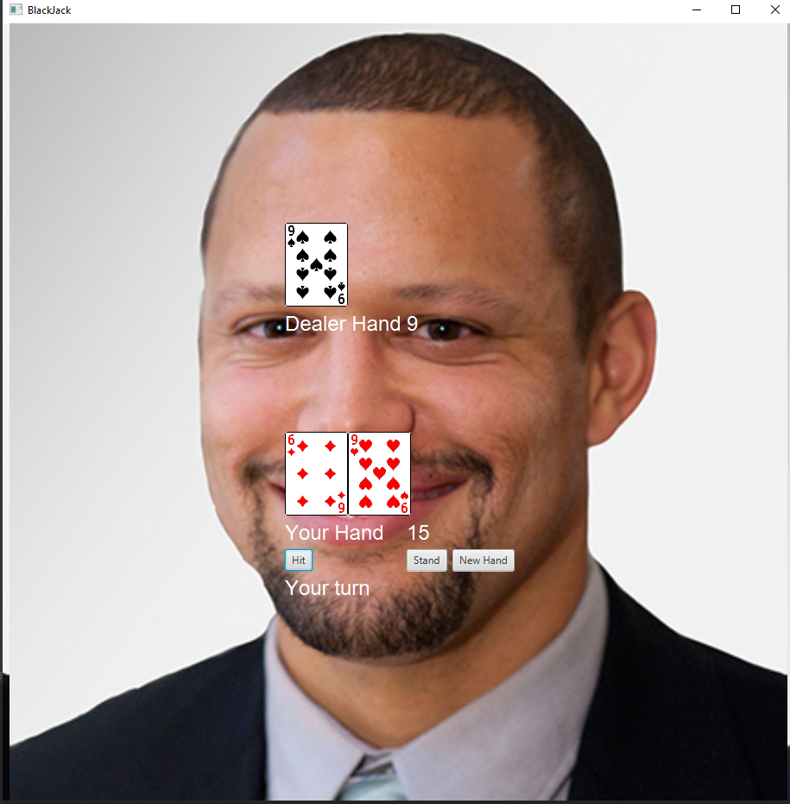
JavaFX
The main library for the GUI implemented in the backend.
Ex: (Not final)

